Slide 1
Ch 6
ANCOVA: Analysis of Covariance
Beckerman et al. p. 145-165

Slide 2
library(HH)
Package to help visualize ANCOVA without extensive coding.
Uses Trellis graphics (lattice package), which has slightly difference syntax than ggplot2.

Slide 3
Analysis of Covariance
In ANOVA, the major feature was that the predictor variable(s) were categorical.
Using the GLM framework we can add a second continuous predictor (now have combination of regression and ANOVA)
Data are limpet.csv
The data relate egg production by limpets to four density conditions in two seasons.
The response variable (y) is egg production (EGGS) and the predictor variables (x’s) are DENSITY (continuous) and SEASON (categorical).
Notes:
Because we are examining egg production along a continuous density
gradient, this is essentially a study of density-dependent reproduction.
The experimental manipulation of density was implemented in spring
and in summer. Thus, a motivation for collecting these data could be
‘does the density dependence of egg production differ between spring and
summer’?

Slide 4
Analysis of Covariance
Because we are examining egg production along a continuous density gradient, this is essentially a study of density-dependent reproduction.
The experimental manipulation of density was implemented in spring and in summer.
Thus, a motivation for collecting these data could be ‘does the density dependence of egg production differ between spring and summer’?
Does egg production differ between seasons after accounting for the effect of density?

Slide 5
Import and check data
limp <- read.csv("limpet.csv")
str(limp)
#'data.frame': 24 obs. of 3 variables:
#$ DENSITY: int 8 8 8 8 8 8 15 15 15 15 ...
#$ SEASON : chr "spring" "spring" "spring" "summer" ...
#$ EGGS : num 2.88 2.62 1.75 2.12 1.5 ...
limp$SEASON <- as.factor(limp$SEASON)
#force SEASON to be considered as a factor, otherwise HH:ancovaplot will throw error (ggplot doesn’t care)

Slide 6
Using the HH package:
ancovaplot(EGGS ~ DENSITY + SEASON, data=limp)
Another advantage is the syntax is identical to that of lm(), which we use to fit a model.
Spring looks higher than summer across all densities
Notes:
Another advantage is the syntax is very similar to that of lm(), which we will use to define model.

Slide 7
Spring looks higher than summer across all densities
ggplot(limp, aes(x = DENSITY, y = EGGS, colour = SEASON)) +
geom_point() +
scale_color_manual(values = c(spring="green", summer="red")) +
theme_bw()

Slide 8
Spring egg production looks higher than summer across all densities
We can describe the relationship between egg production and density by a straight line [y=mx + b] (ignore the season for the moment)
Then y is egg production, x is density, b is where the line crosses the y-axis (intercept), and m is the slope of the egg production density relationship.
This slope represents the change in egg production per unit change in density—that is, the strength of density dependence.

Slide 9
Interpreting the Figure: It’s All About Lines
Consider all the possible patterns that we might have found, and the different hypotheses, or interpretations, they represent.
We can do this using the slope and intercept of the lines describing each level of our factor of interest (group).

Slide 10
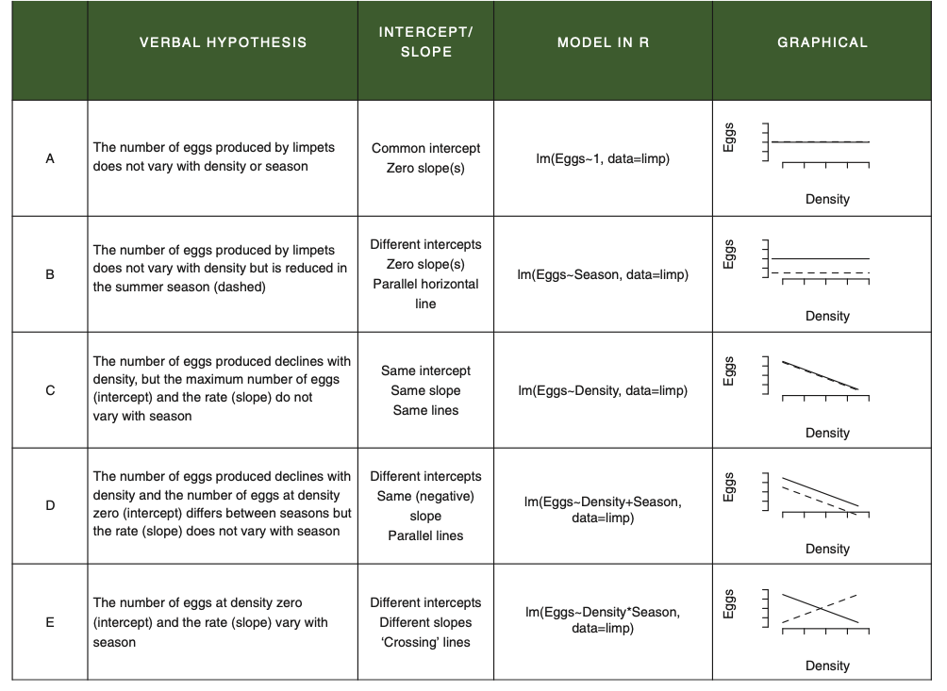
We might ignore A and B—it seems clear from the data that there is a decline, on average,
in egg production with density.
C is clearly possible; again, more so if the variation in egg production in each season is high.
D and E are compelling. Because we can’t actually see whether there are different slopes
and intercepts, we can use statistics.

Slide 11
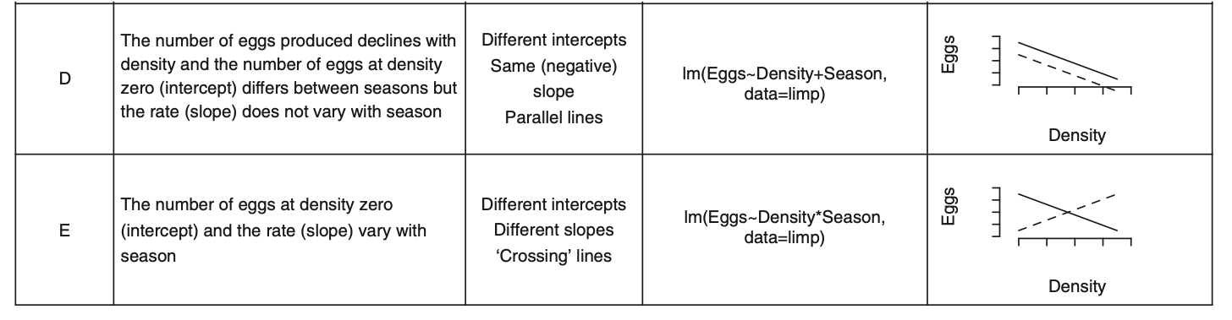
Assessing Interaction Terms
Important to understand that the difference in models D and E is the presence (E) or absence (D) of an interaction term that specifies whether the slopes are different.
This interaction is embodied in the following sentence: ‘The effect of density on egg production depends on the season.’ (contingent inference)
Notice syntax in model specification; + vs. *

Slide 12
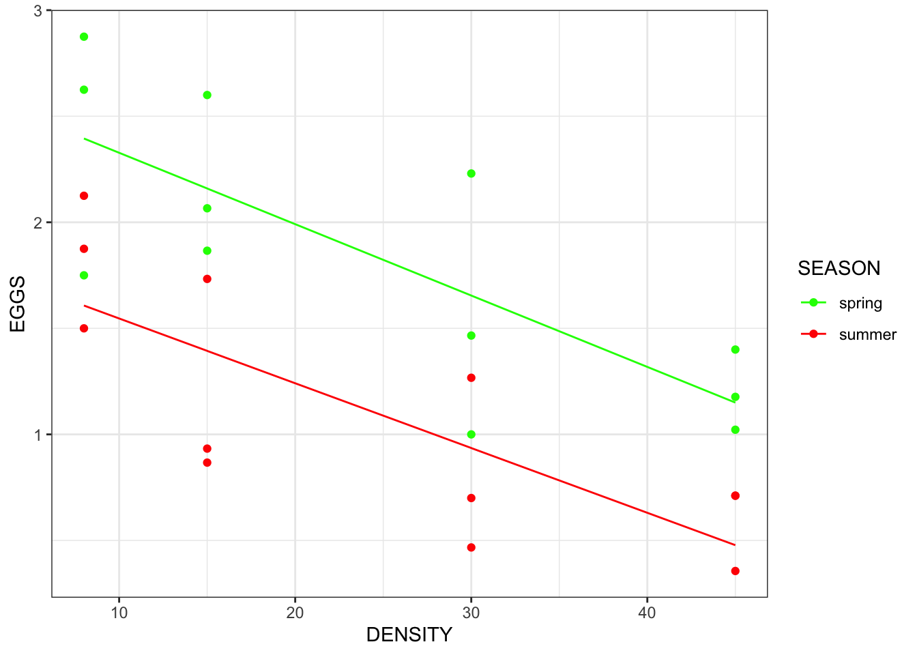
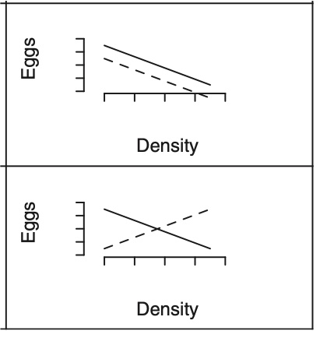
Do we get a better description of the data by using more than one intercept and more than one slope?
In the case of these data, if we assume that the researchers were testing whether ‘The effect of density on egg production depends on the season’, then in fact we are not equally interested in all the hypotheses:
We are starting with the belief that limpet density has an effect on egg production, and we are focusing on whether this effect differs between seasons; that is, we are really interested in whether the data are better described by model E than by model D.
D
E

Slide 13
Constructing the ANCOVA Using lm()
limp.mod <- lm(EGGS ~ DENSITY * SEASON, data = limp)
Specifies, all at once, that we want to include an effect of DENSITY (main effect), an effect of SEASON (main effect), and the potential for the effect of DENSITY to depend on SEASON (interaction; symbolized by *).
The specification expands to the full model of
DENSITY + SEASON + DENSITY:SEASON.
Since we are interested in whether the effect of density depends on season, we need a model where there is, in addition to the effects of density and season on their own, a specific term allowing for their interaction, that is, in which the effect of density on egg production could depend on season.
Notes:
Recall that we already made SEASON a factor in slide 5:
limp$SEASON <- as.factor(limp$SEASON)

Slide 14
Why do we say ‘could’? We are testing the null hypothesis that this interaction term is not significant: there are no differences in the slopes for each season; there is no extra variation explained by fitting different slopes.
The alternative is that, by allowing separate slopes to be fitted, we explain more variation in the data (better fit).

Slide 15
Test Model Assumptions
autoplot(limp.mod, smooth.colour = NA)
No obvious problems.
We’ve made a model to capture our ideas, and, more importantly, an experimental design.
We’ve evaluated the core assumptions associated with a general linear model.
Now you’re ready for interpretation.

Slide 16
Interpretation: The anova() table
Recall we have used two functions to aid in interpretation of a general linear model: anova() and summary().
Together, the resulting two tables help us interpret the relationships between egg production and the combined or independent impact of density and season.
anova(limp.mod)
## Analysis of Variance Table
##
## Response: EGGS
## Df Sum Sq Mean Sq F value Pr(>F)
## DENSITY 1 5.0241 5.0241 30.1971 2.226e-05 ***
## SEASON 1 3.2502 3.2502 19.5350 0.0002637 ***
## DENSITY:SEASON 1 0.0118 0.0118 0.0711 0.7925333
## Residuals 20 3.3275 0.1664
## ---
## Signif. codes:
## 0 '***' 0.001 '**' 0.01 '*' 0.05 '.' 0.1 ' ' 1
Notes:
Can always use options(digits=3) to force three significant digits in the output
Like the 2-way ANOVA, this tests three null hypotheses!!!!! (Density, Season, and their Interaction)

Slide 17

anova(limp.mod) #sequential sums-of-squares ANOVA
## Analysis of Variance Table
##
## Response: EGGS
## Df Sum Sq Mean Sq F value Pr(>F)
## DENSITY 1 5.0241 5.0241 30.1971 2.226e-05 ***
## SEASON 1 3.2502 3.2502 19.5350 0.0002637 ***
## DENSITY:SEASON 1 0.0118 0.0118 0.0711 0.792533
## Residuals 20 3.3275 0.1664
## ---
## Signif. codes:
## 0 '***' 0.001 '**' 0.01 '*' 0.05 '.' 0.1 ' ' 1
test combined slope = 0
Test that difference
between adjusted
means = 0
Test that group-specific
regression lines
have different slopes
(interaction)
We tested the hypothesis that the effect of density on egg production in limpets depends on the season in which they are reproducing. We found no evidence for an interaction between density and season (F = 0.0711; df = 1, 20; p = 0.79), indicating that the effects of density and season are additive.

Slide 18
Interpretation: The summary() table
Call:
lm(formula = EGGS ~ DENSITY * SEASON, data = limp)
Residuals:
Min 1Q Median 3Q Max
-0.65468 -0.25021 -0.03318 0.28335 0.57532
Coefficients:
Estimate Std. Error t value Pr(>|t|)
(Intercept) 2.664166 0.234118 11.380 3.45e-10 ***
DENSITY -0.033650 0.008259 -4.074 0.000591 ***
SEASONsummer -0.812282 0.331092 -2.453 0.023450 *
DENSITY:SEASONsummer 0.003114 0.011680 0.267 0.792533
---
Signif. codes: 0 ‘***’ 0.001 ‘**’ 0.01 ‘*’ 0.05 ‘.’ 0.1 ‘ ’ 1
Residual standard error: 0.4079 on 20 degrees of freedom
Multiple R-squared: 0.7135, Adjusted R-squared: 0.6705
F-statistic: 16.6 on 3 and 20 DF, p-value: 1.186e-05
Explained variance = 0.67
Model with Density + Season + Interaction fits better than null model (only a mean) (F = 16.6, df = 3,20, p < 0.001)

Slide 19
Interpretation: The summary() table
Call:
lm(formula = EGGS ~ DENSITY * SEASON, data = limp)
Residuals:
Min 1Q Median 3Q Max
-0.65468 -0.25021 -0.03318 0.28335 0.57532
Coefficients:
Estimate Std. Error t value Pr(>|t|)
(Intercept) 2.664166 0.234118 11.380 3.45e-10 ***
DENSITY -0.033650 0.008259 -4.074 0.000591 ***
SEASONsummer -0.812282 0.331092 -2.453 0.023450 *
DENSITY:SEASONsummer 0.003114 0.011680 0.267 0.792533
EGGS_{spring} = 2.66 – 0.033 X DENSITY
EGGS_{summer} = (2.66 – 0.812) + (–0.033 + 0.003) X DENSITY
EGGS_{summer} = 1.84 – 0.03 X DENSITY
SEASONsummer, is the difference
between the spring (the reference) and the summer intercept
DENSITY:SEASONsummer the
difference between the slopes for
spring and summer
Technically, we usually remove N.S. interactions to get a Minimum Adequate Model.
Notes:
This output isn’t really that helpful unless you are trying to combine the coefficients to use in prediction (e.g. get new predicted values of egg production based on given values of density and season).

Slide 20
So, refit model, but remove the interaction.
Technically, we usually remove non-significant interactions to get a Minimum Adequate Model. In this case that is good, because a model with no interaction is MUCH easier to interpret.
limp.mod.nointeraction <- lm(EGGS ~ DENSITY + SEASON, data = limp)
Includes an effect of DENSITY (main effect),
Includes an effect of SEASON (main effect),
Does NOT include an interaction

Slide 21
Putting Lines on the Figure
Using ggplot2 is undoubtedly better for a publication, but for simplicity we used HH::ancovaplot
Separate slopes plot
ancovaplot(EGGS ~ DENSITY * SEASON, data=limp)
Same slopes plot
ancovaplot(EGGS ~ DENSITY + SEASON, data=limp)
Can you tell the difference? Probably not since the interaction
Only accounted for a small amount of variation in the first model (0.0118;
look at anova table). Can compare the two models using anova().
Notes:
#compare the two models
anova(limp.mod, limp.mod.nointeraction)
#they have statistically similar explanatory power

Slide 22
Compare Models
anova(limp.mod, limp.mod.nointeraction)
#Analysis of Variance Table
#Model 1: EGGS ~ DENSITY * SEASON
#Model 2: EGGS ~ DENSITY + SEASON
# Res.Df RSS Df Sum of Sq F Pr(>F)
#1 20 3.3275
#2 21 3.3394 -1 -0.011822 0.0711 0.7925
Not much evidence that the model with the interaction fits better than the model without the interaction (P=0.79).
Statistically indistinguishable, so we usually use the most parsimonious explanation (the simplest model).
Because slopes are the same (modeled as no interaction), we can interpret the means without contingent inference; difference in means doesn’t depend on where you choose to look at the relationship.

Slide 23
Calculate means using the ‘best’ model
emm_limp.mod.nointeraction <- emmeans(limp.mod.nointeraction, "SEASON")
emm_limp.mod.nointeraction
# SEASON emmean SE df lower.CL upper.CL
# spring 1.84 0.115 21 1.600 2.08
# summer 1.10 0.115 21 0.864 1.34
#Confidence level used: 0.95
If we adjusted all the points to the mean of density, these would be the adjusted means (estimated marginal means or least-square means).
Difference is 0.74 (see summary table for the ‘no interaction’ model) and that difference is the same across the range of density because slopes are equal.

Slide 24
Adjusted Means: Useful when slopes are equal (no sig. interaction)
Difference at the mean of DENSITY is 0.74 EGGS

Slide 25
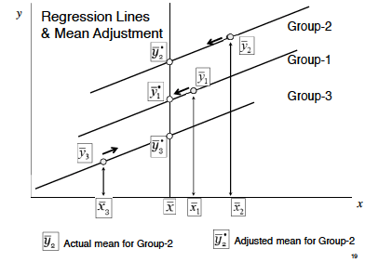
Slightly Different Way of Thinking About ANCOVA: Removing confounding variation by adjusting group means to a common point of comparison, the covariate mean (grand mean)

Slide 26
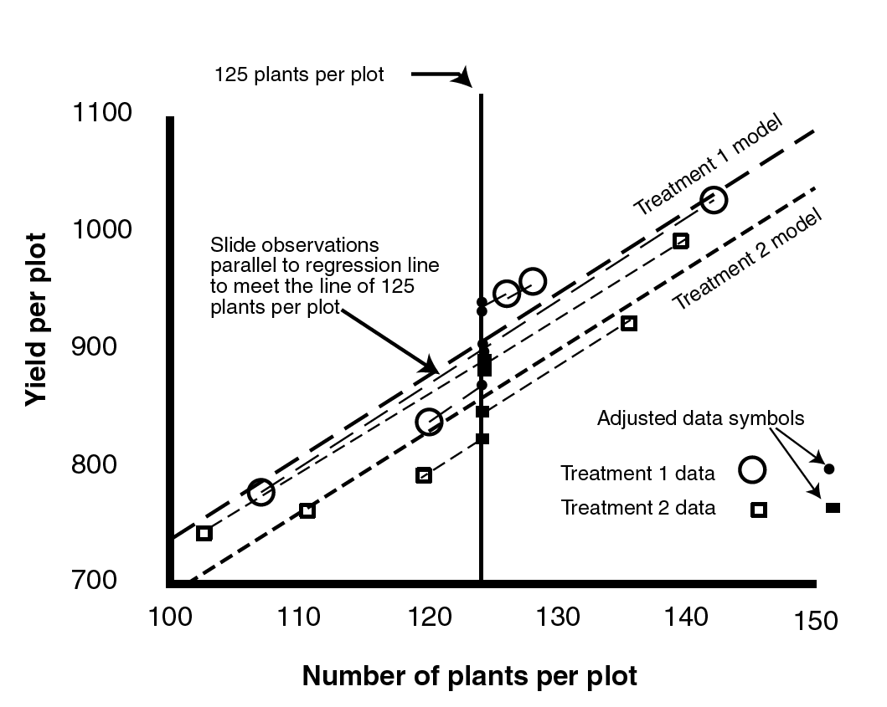
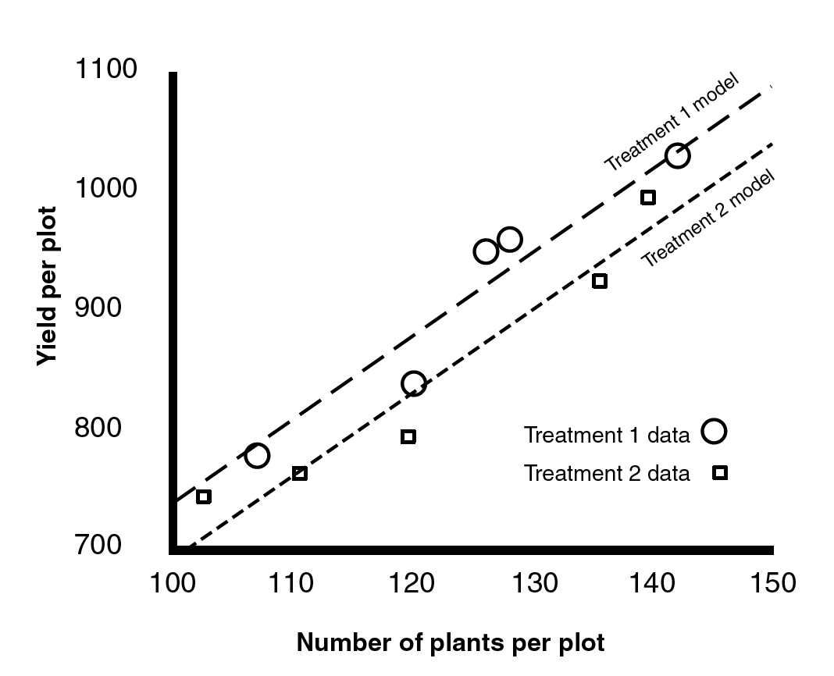
ANCOVA
Tests for differences between (among) 2 or more groups after removing the effect of a confounding covariate (via regression).
Diagrammatic representation of adjusted means procedure in ANCOVA. The adjusted Y means are based on the overall X mean, not the X means for each group.
Slides each data point to the mean value of X (based on common slope); then conduct ANOVA.
Notes:
Figures from Milliken and Johnson 2002. Analysis of Messy Data III.
Have .JMP file to demonstrate.

Slide 27
ANCOVA
Analysis of Covariance combines elements from regression and elements from ANOVA. The response variable is continuous, and there is at least one continuous predictor variable AND at least one categorical predictor variable.
General Procedures:
Fit 2 or more linear regressions of y against x (one for each level of the factor
Estimate different slopes and intercepts for each level
Use model simplification (deletion tests) to drop unnecessary parameters (e.g. non-sig. interaction terms).
Notes:
Crawley, 2007. p. 489.

Slide 28
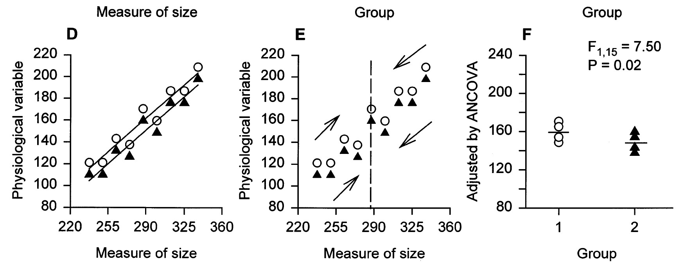
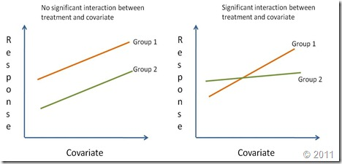
ANCOVA = Regression + ANOVA
Today we will consider an example in which there is no significant interaction, and the above model is relevant.
Significant interactions are sometimes difficult to interpret; recall ‘contingent inference’.
Notes:
Adjusted means figure from Packard and Boardman 1999.
We can also examine the data by ANCOVA.
Regression lines are fit to each of the data sets (Fig. 3D) and the slopes are evaluated.
The slopes do not differ significantly (indeed, they are identical in this case), so we compute a weighted mean.
This average slope is used to adjust values for the physiological variable to a common value for body size (Fig. 3E) and an ANOVA is then performed on the adjusted values (Fig. 3F).
A plot of adjusted data reveals that values for the physiological variable are the same for animals in Group 1 as for those in Group 2 once confounding effects of body size have been removed and this impression is supported by outcome of the ANOVA.

Slide 29
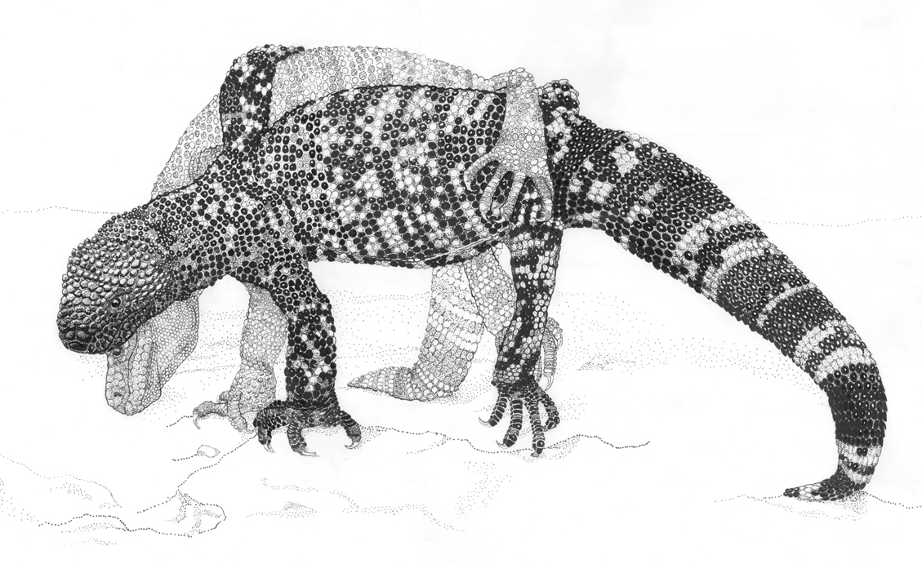
ANCOVA
Tests for differences between (among) 2 or more groups after removing the effect of a confounding covariate (via regression).
Background and Biological Hypothesis: Because male beaded lizards fight for access to reproductive females, natural selection may act on body structures involved in combat (heads, tails, etc.). Since only males fight, we might expect that selection would produce males with larger “weapons” than females.
https://www.youtube.com/watch?v=Yja8Mf9Jsr8
But we have an important
issue that could confound this analysis. What is it?
Larger animals have larger body parts, regardless of sex.

Slide 30
ANCOVA
Statistical Hypothesis:
H_{o}: Mean_{males} = Mean_{females}
H_{a}: Mean_{males} ≠ Mean_{females}
Statistical Hypothesis:
H_{o}: Adj. Mean_{males} = Adj. Mean_{females}
H_{a}: Adj. Mean_{males} ≠ Adj. Mean_{females}
This analysis tells us that our ANCOVA model (with 2 predictors) is sig. different than the null model.
This analysis doesn’t account for confounding factor of body size on tail length.

Slide 31
ANCOVA
Tests for differences between (among) 2 or more groups after removing the effect of a confounding covariate (via regression).
Statistical Hypothesis: SEX
H_{o}: Adj. Mean_{males} = Adj. Mean_{females}
H_{a}: Adj. Mean_{males} ≠ Adj. Mean_{females}
Statistical Hypothesis: BODY LENGTH
H_{o}: slope = 0
H_{a}: slope ≠ 0
“There was a significant effect of body length on tail length of beaded lizards (F_{1,49} = 75.61, P < 0.001) and tail lengths differed significantly between sexes after accounting for body length (F_{1,49} = 16.18, P = 0.0002).”

Slide 32
ANCOVA
Tests for differences between (among) 2 or more groups after removing the effect of a confounding covariate (via regression).
“There was a significant effect of body length on tail length of beaded lizards (F_{1,49} = 75.61, P < 0.001) and tail lengths differed significantly between sexes after accounting for body length (F_{1,49} = 16.18, P = 0.0002).”
May also choose to report Least-squares means, also called ‘adjusted means’. These are the means of the response variable (tail length) at each level of the main effect (sex) AFTER being adjusted to the mean of the covariate (body length; 335.5 mm).
“LS means for tail length were 234.6(5.0) mm for females and 263.2(5.0) mm for males.”
Mean of covariate
LS means

Slide 33
Practice – Sexual Dimorphism Lizard Tials
Try with the lizard tail data (tail_length.csv).
Review worked limpets example.
Fit full model
Thrown out N.S. interactions if they don’t help explain
Interpret final model (each of the null hypotheses)
Report Adjusted Means (LS Means) for context

Slide 34
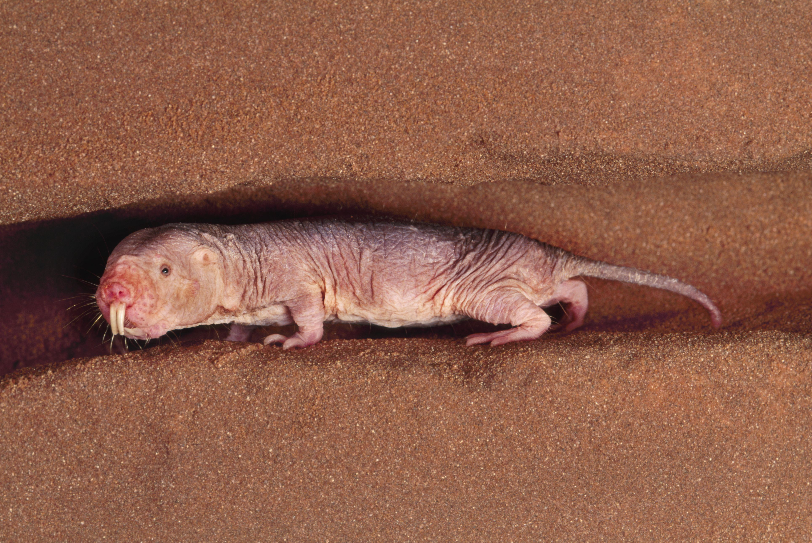
Practice - Molerats
Mole rats are the only known mammals with distinct social castes. A single queen and a small number of males are the only reproducing individuals in a colony. Remaining individuals, called workers, gather food, defend the colony, care for the young, and maintain the burrows. “Frequent workers” do almost all of the work in the colony, whereas “infrequent workers” (lazy) do little work except on rare occasions after rains, when they extend the burrow system. To assess the physiological differences between the two types of workers, Scantlebury et al. (2006) compared daily energy expenditures of wild mole rats during a dry season. Energy expenditure appears to increase with body mass in both groups, but infrequent workers are heavier than frequent workers.
How different is mean daily energy expenditure between the two groups when adjusted for differences in body mass? (*data are presented as nat. logs; data are molerat.csv)

Slide 35
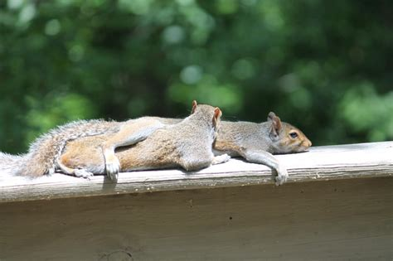


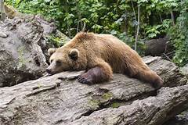
Practice – Mammal REM Sleep
Data are msleep (built into ggplot2)
You are comparing sleep patterns of two specific orders of mammals.
The more an animal sleeps the more total REM sleep in gets.
After accounting for total sleep, what is the relationship between carnivore and rodent REM sleep?

Slide 36
Review: Make ggplots for ANCOVA
# specify the ANCOVA model; separate slopes or same slopes
limp.mod <- lm(EGGS ~ DENSITY * SEASON, data = limp)
limp.mod <- lm(EGGS ~ DENSITY + SEASON, data = limp)
# generate prediction lines from the model; put lines on top of plot
# if we defined a model with an interaction (*), lines are free to have different slopes
limp.mod.predictions <- predict(limp.mod)
# make ggplot with prediction lines on top
ggplot(limp, aes(x = DENSITY, y = EGGS, colour = SEASON)) +
geom_point() +
geom_line(aes(y=limp.mod.predictions))+
scale_color_manual(values = c(spring="green", summer="red")) +
theme_bw()

Slide 37
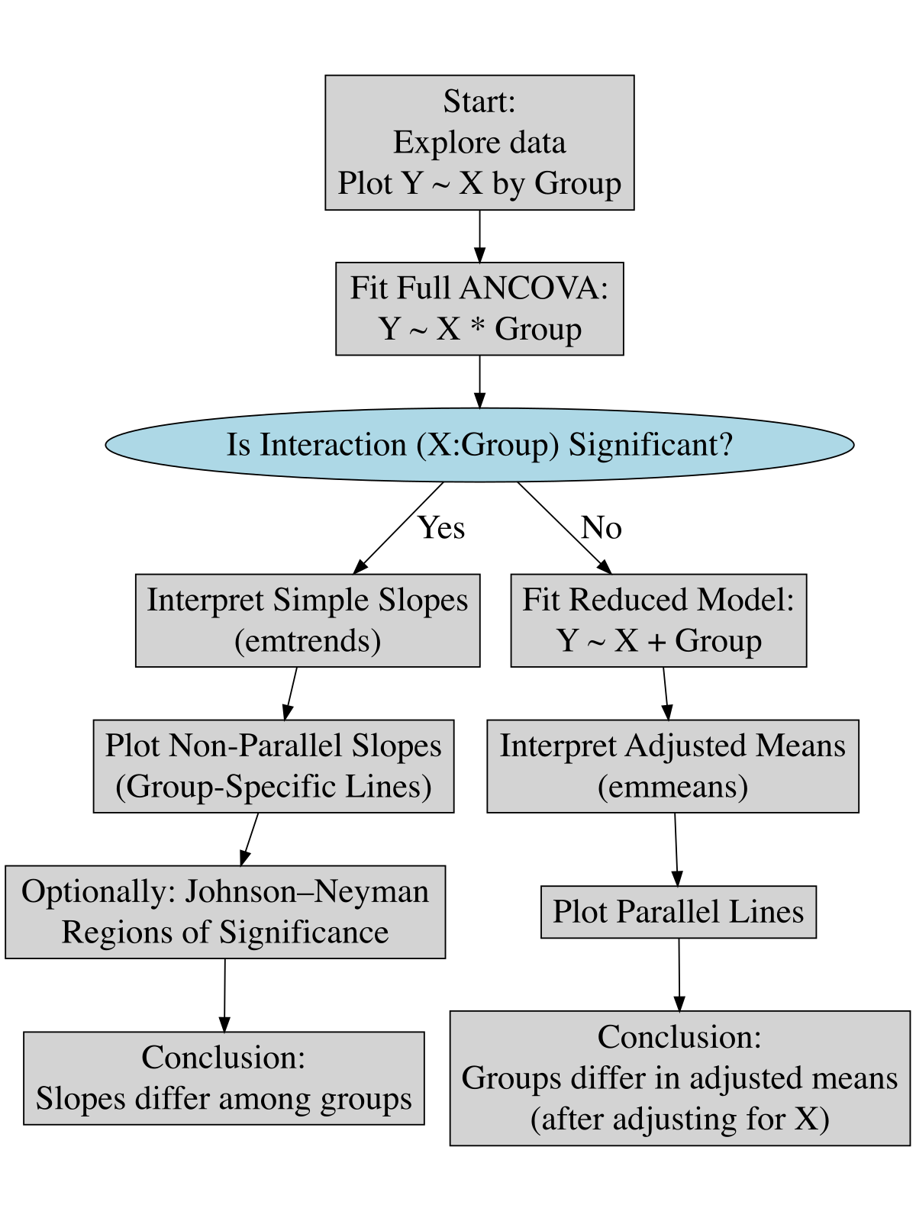
ANCOVA Flow Chart

Slide 39
Comparing More than 2 Levels of the Categorical Predictor Variable (same Slopes Model)
Can use emmeans to calculate differences among adjusted means
Can use multcomp in the same way we did for 1 and 2 way ANOVAs (all are GLMs)

